Slide 1
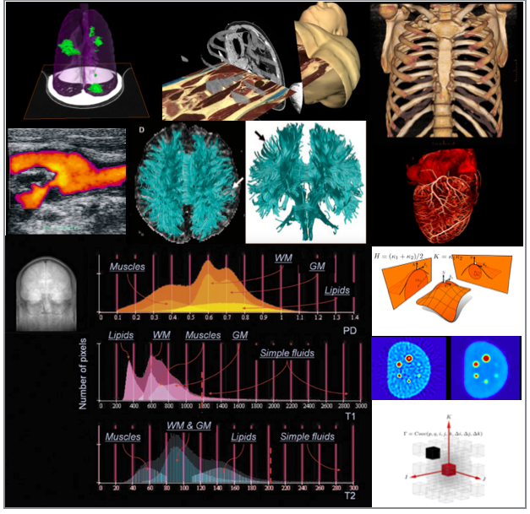
Federated Learning for Medical Image Analysis
Hongyi Pan, Ph.D.,
Postdoctoral Research Fellow,
Machine & Hybrid Intelligence Lab,
Department of Radiology, Feinberg School of Medicine,
Northwestern University,
737 N. Michigan Avenue Suite 1600,
Chicago, IL 60611, USA
hongyi.pan@northwestern.edu
Web: https://www.bagcilab.com

Slide 2
Outline
1. Introduction to federated learning
2. Mainstream federated learning algorithms
Federated Averaging (FedAvg)
Federated Optimization in Heterogeneous Networks (FedProx)
Federated domain generalization
3. Federated learning for medical image analysis
Pancreas MRI IPMN Risk Classification
Polyp Segmentation

Slide 3
How to train a model well?
Optimized training strategy (suitable learning rate, etc.)
More data!

Slide 4
Issues on data from multiple centers
Data privacy restriction
Data communication limitation
We want to train a network without sharing the images from a center to another.
Solution: Federated learning!

Slide 5
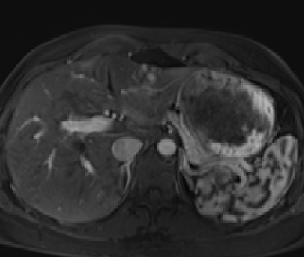
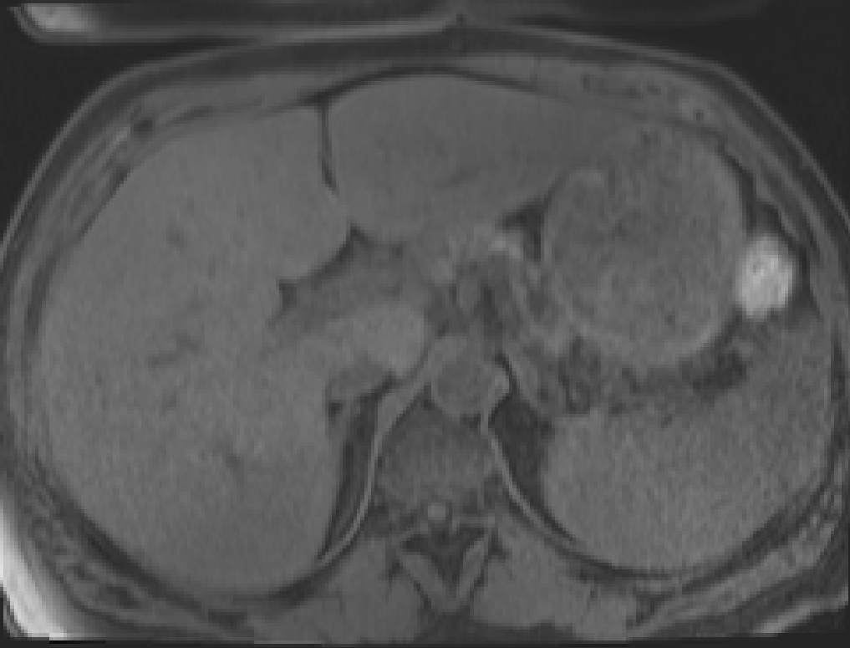

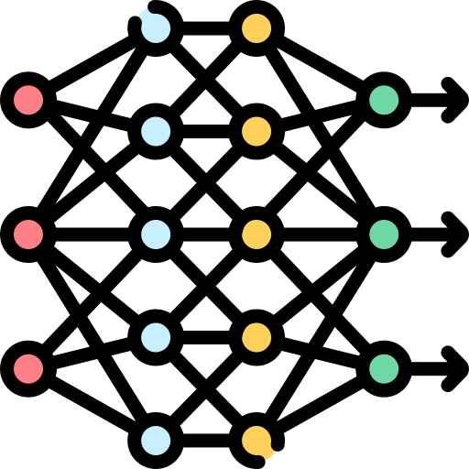
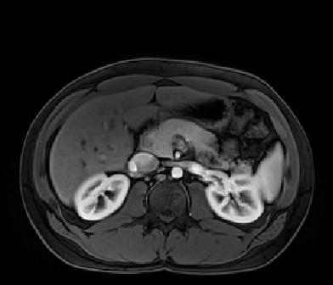
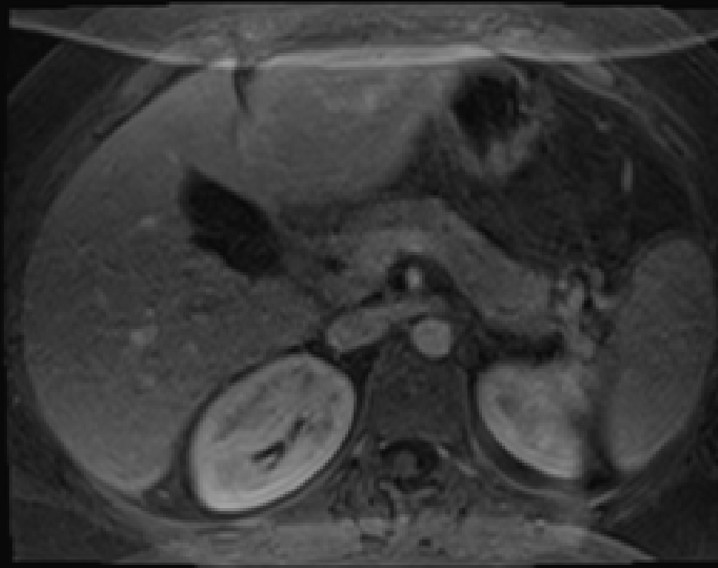
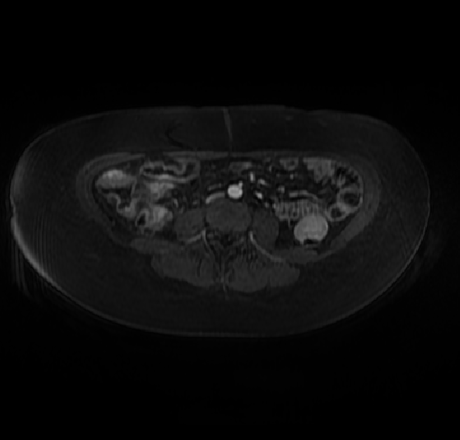
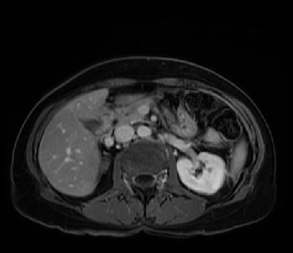
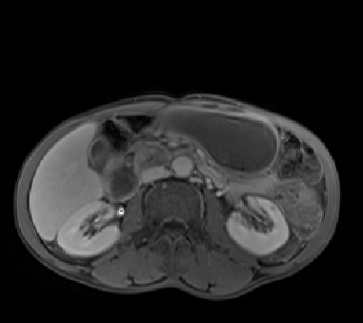
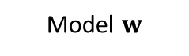


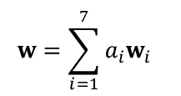







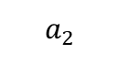




What’s Federated Learning?
We cannot share the data, but we can share the model weights.
Aggregation
$$w=\sum_{i=1}^{7}{{a_{i}w}_{i} }$$
Client 1
Model $w_{1}$
Model $w_{7}$
Pancreas MRI
$$a_{1}$$
$$a_{7}$$
Pancreas MRI
Client 7
$$a_{2}$$
$$a_{6}$$
Model $w_{2}$
Model $w$
Model $w_{6}$
Client 2
Pancreas MRI
Server
Pancreas MRI
Client 6
$$a_{3}$$
$$a_{4}$$
$$a_{5}$$
Model $w_{5}$
Model $w_{3}$
Pancreas MRI
Client 5
Client 3
Pancreas MRI
Model $w_{4}$
Client 4
Pancreas MRI

Slide 6
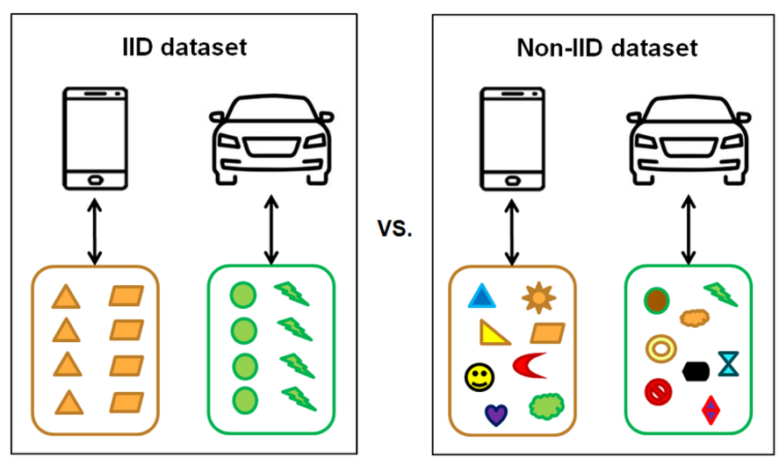
IID Dataset VS Non-IID Dataset
IID: Independent and identically distributed.
Non-IID is more common.

Slide 7
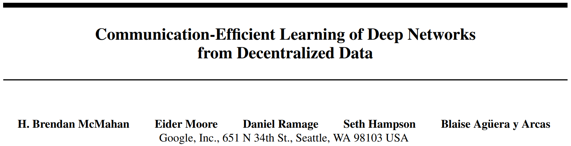
Federated Averaging (FedAvg)
McMahan, Brendan, Eider Moore, Daniel Ramage, Seth Hampson, and Blaise Aguera y Arcas. "Communication-efficient learning of deep networks from decentralized data." In Artificial intelligence and statistics, pp. 1273-1282. PMLR, 2017.

Slide 8
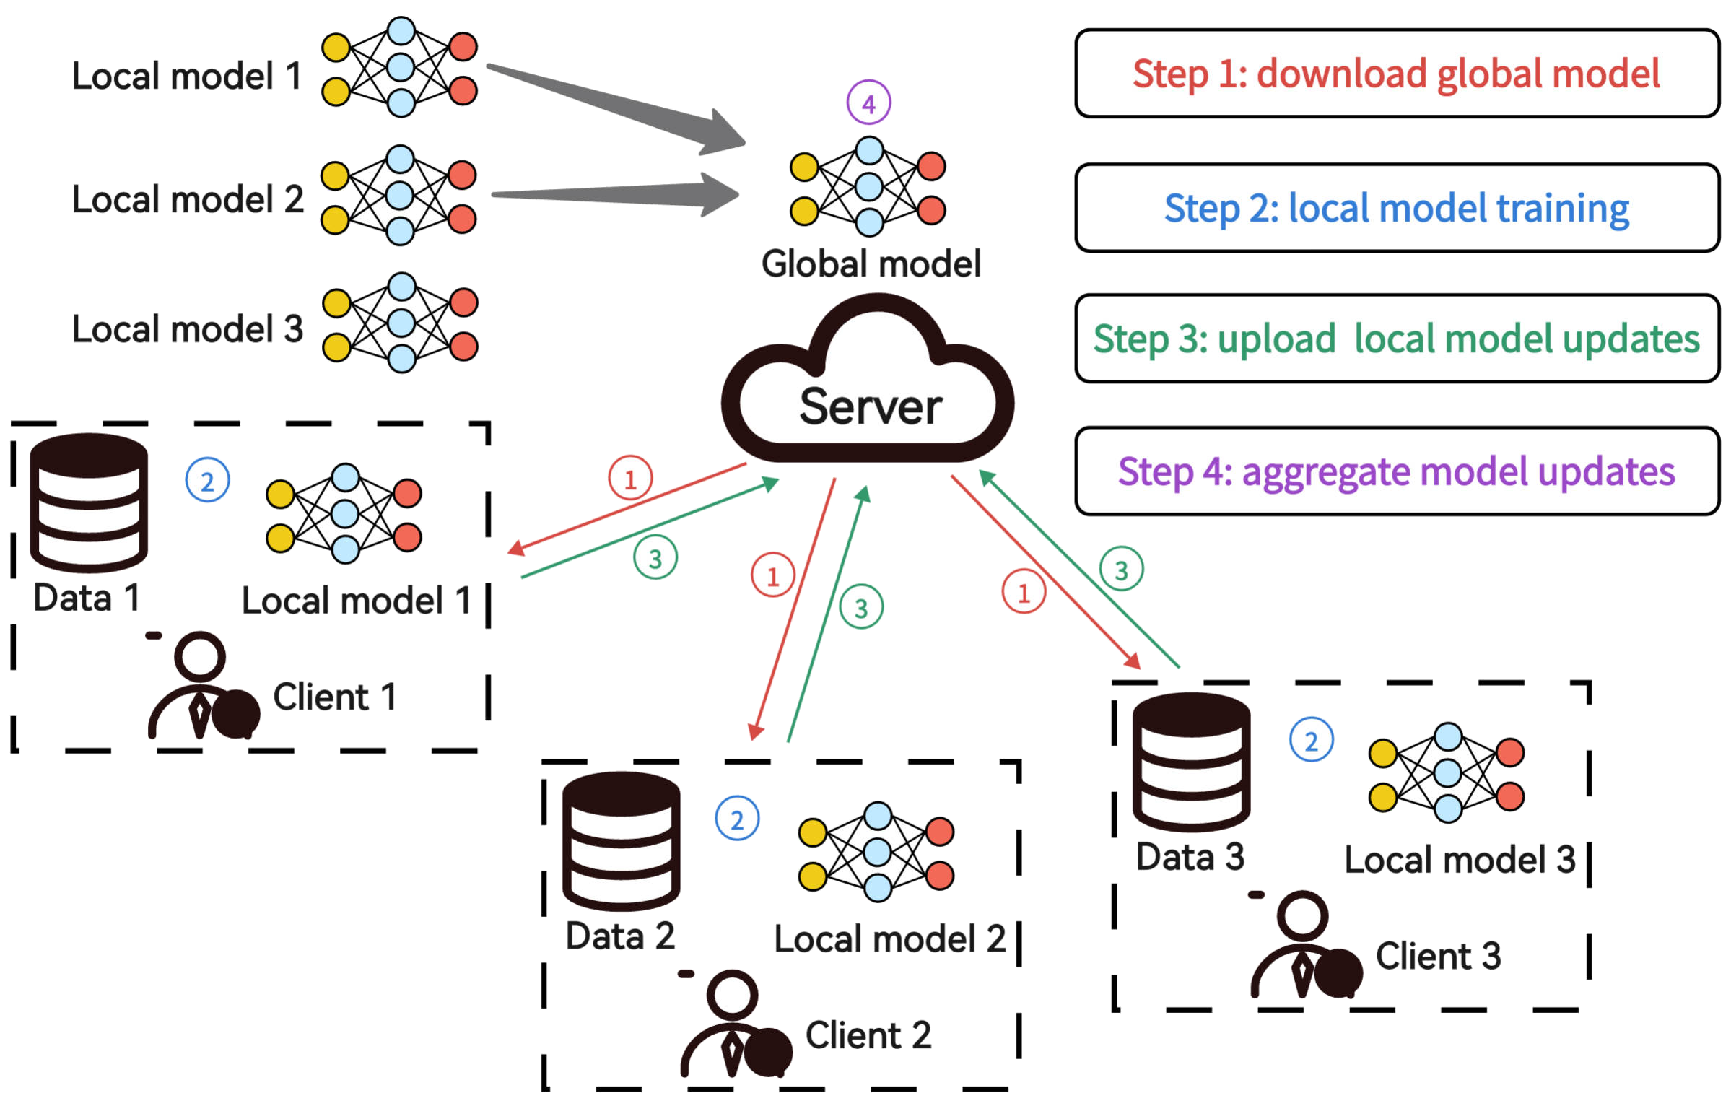
Federated Averaging (FedAvg)
$$w^{t}→w^{t+1}$$

Slide 9
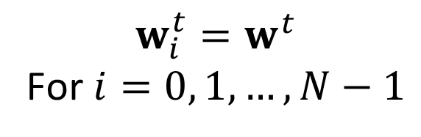
Federated Averaging (FedAvg)
$$w_{i}^{t}=w^{t}$$
For $i=0, 1, …, N−1$

Slide 10
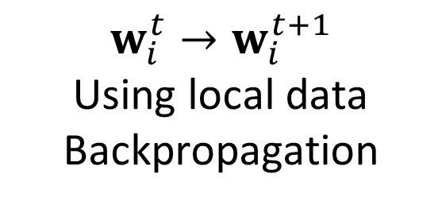
Federated Averaging (FedAvg)
$$w_{i}^{t}→w_{i}^{t+1}$$
Using local data
Backpropagation

Slide 11
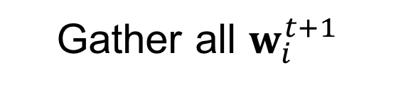
Federated Averaging (FedAvg)
Gather all $w_{i}^{t+1}$

Slide 12
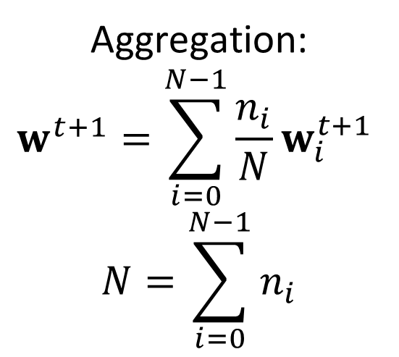
Federated Averaging (FedAvg)
Aggregation:
$$w^{t+1}=\sum_{i=0}^{N−1}{{\frac{n_{i}}{N}w}_{i}^{t+1} }$$
$$N=\sum_{i=0}^{N−1}{n_{i}}$$

Slide 13
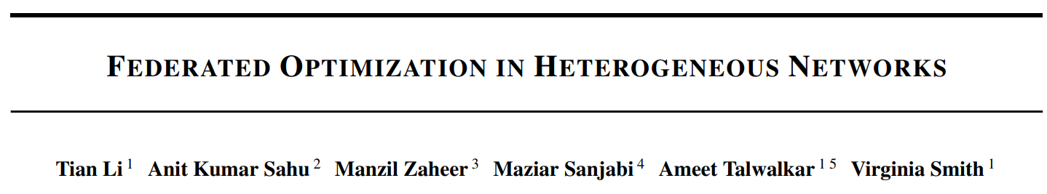
Federated Optimization in Heterogeneous Networks (FedProx)
Li, Tian, Anit Kumar Sahu, Manzil Zaheer, Maziar Sanjabi, Ameet Talwalkar, and Virginia Smith. "Federated optimization in heterogeneous networks." Proceedings of Machine learning and systems 2 (2020): 429-450.

Slide 14
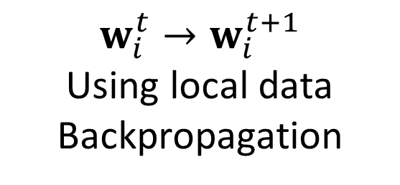
Federated Optimization in Heterogeneous Networks (FedProx)
$$w_{i}^{t}→w_{i}^{t+1}$$
Using local data
Backpropagation

Slide 15
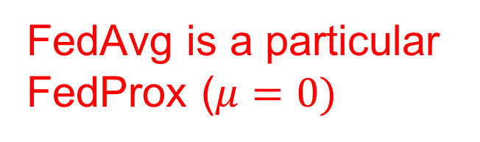
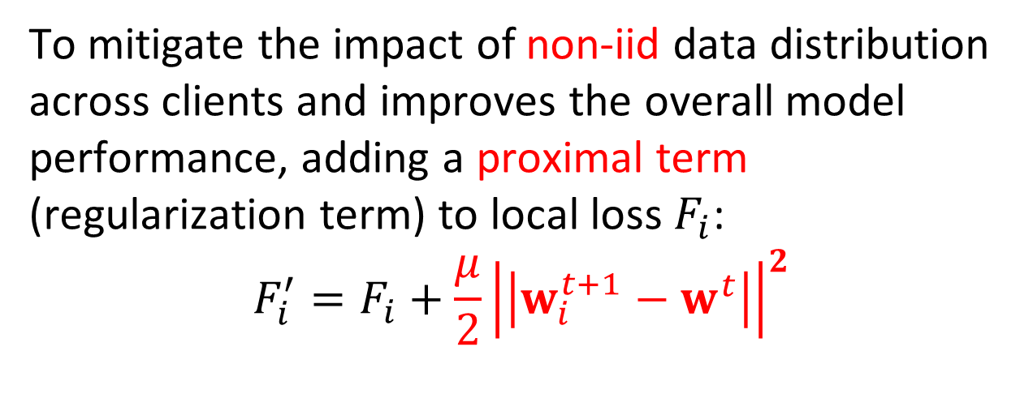
Federated Optimization in Heterogeneous Networks (FedProx)
To mitigate the impact of non-iid data distribution across clients and improves the overall model performance, adding a proximal term (regularization term) to local loss $F_{i}$:
$$F_{i}^{′}=F_{i}+\frac{μ}{2}{\left|\left|w_{i}^{t+1}−w^{t}\right|\right|}^{2}$$
FedAvg is a particular
FedProx ($μ=0)$

Slide 16
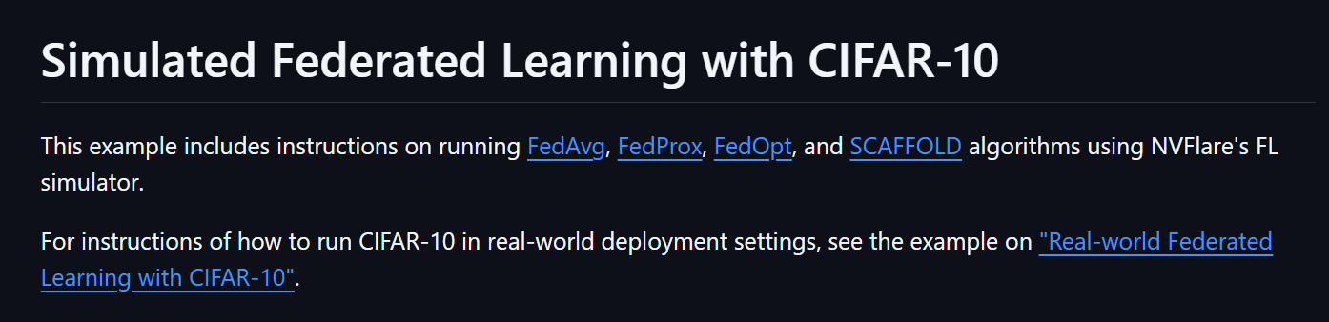
Examples: CIFAR10 by NVIDIA NVFlare
https://github.com/NVIDIA/NVFlare/tree/main/examples/advanced/cifar10/cifar10-sim

Slide 17
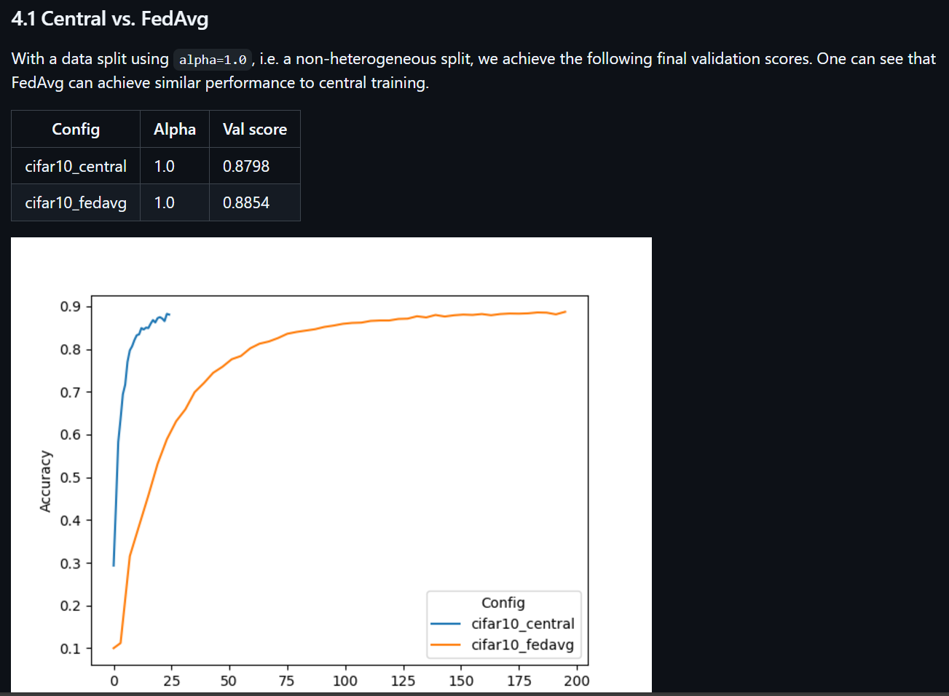
Examples: CIFAR10 by NVIDIA NVFlare
FedAvg can reach similar as centralized on IID dataset.
Slower convergence.

Slide 18
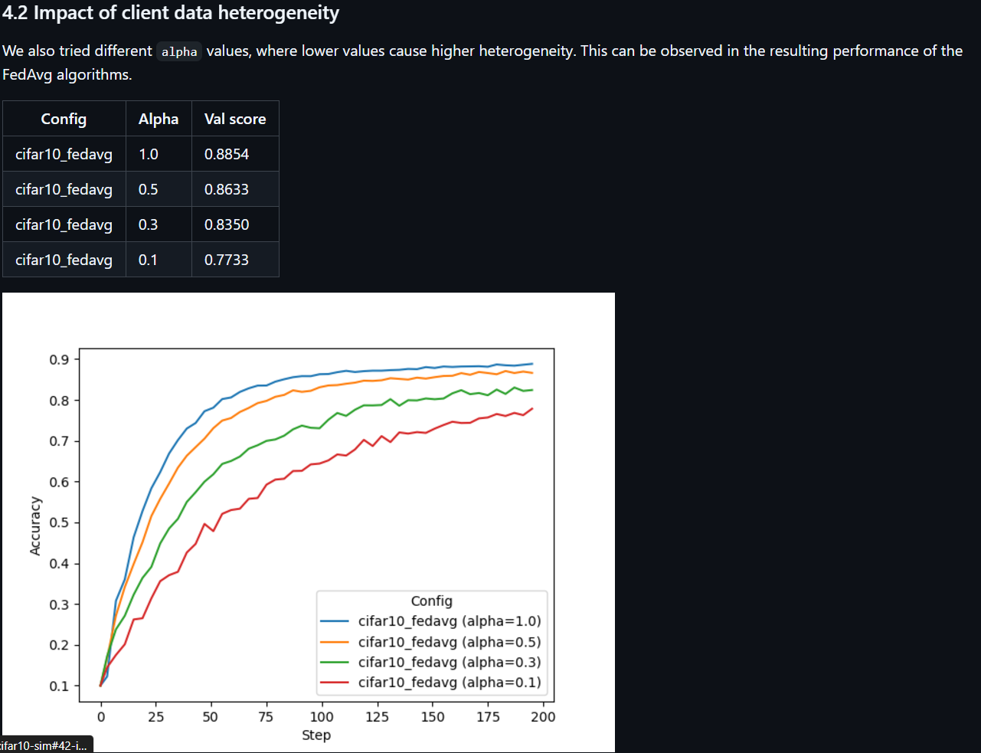
Examples: CIFAR10 by NVIDIA NVFlare
FedAvg’s performance drops on non IID dataset

Slide 19
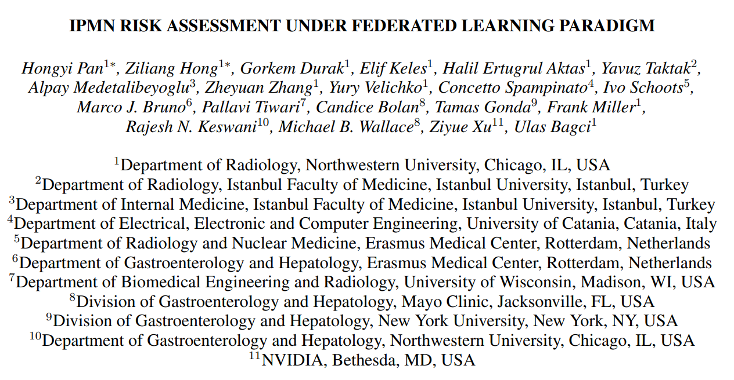
Federated learning for medical image analysis: Pancreas MRI IPMN Risk Classification
Pan, Hongyi, Ziliang Hong, Gorkem Durak, Elif Keles, Halil Ertugrul Aktas, Yavuz Taktak, Alpay Medetalibeyoglu et al. "IPMN Risk Assessment under Federated Learning Paradigm." arXiv preprint arXiv:2411.05697 (2024).

Slide 20
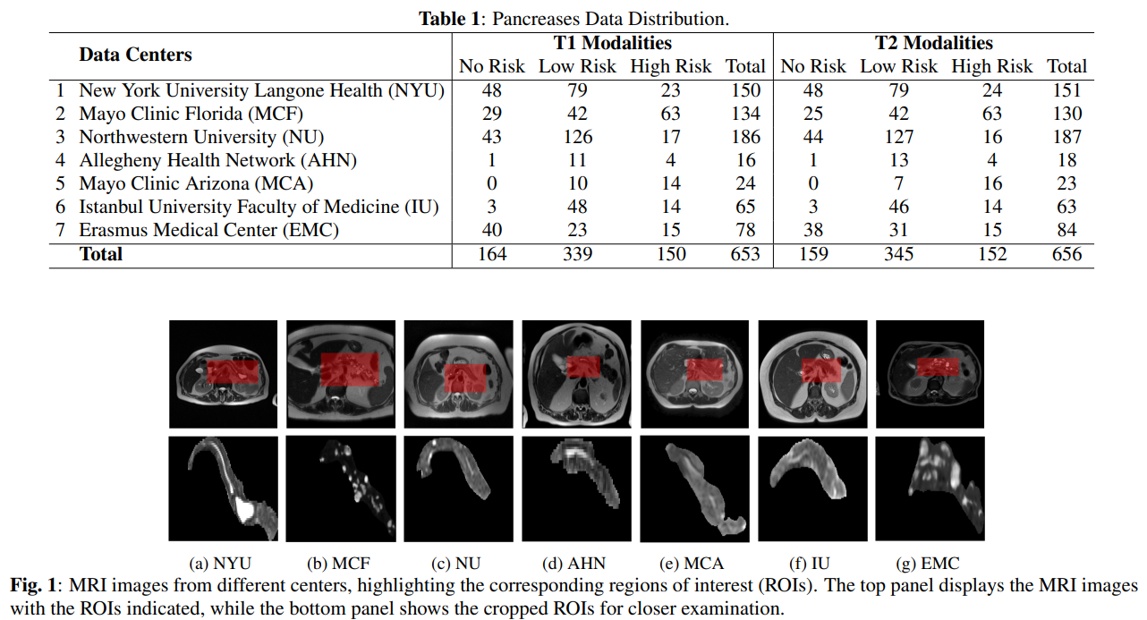
Federated learning for medical image analysis: Pancreas MRI IPMN Risk Classification

Slide 21
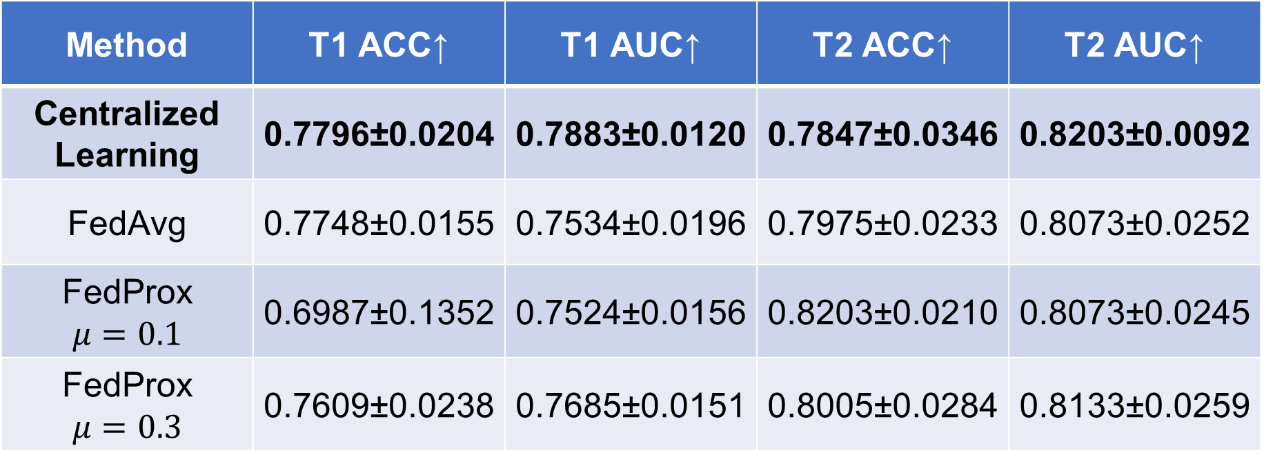
Federated learning for medical image analysis: Pancreas MRI IPMN Risk Classification
Method | T1 ACC↑ | T1 AUC↑ | T2 ACC↑ | T2 AUC↑
Centralized Learning | 0.7796±0.0204 | 0.7883±0.0120 | 0.7847±0.0346 | 0.8203±0.0092
FedAvg | 0.7748±0.0155 | 0.7534±0.0196 | 0.7975±0.0233 | 0.8073±0.0252
FedProx $$μ=0.1$$ | 0.6987±0.1352 | 0.7524±0.0156 | 0.8203±0.0210 | 0.8073±0.0245
FedProx $$μ=0.3$$ | 0.7609±0.0238 | 0.7685±0.0151 | 0.8005±0.0284 | 0.8133±0.0259
DenseNet-121 with 4-fold cross validation is used in this work.

Slide 22
Federated Domain Generalization
In FL, we cannot share images among clients.
However, we may do domain generalization to reduce data heterogeneity (data distribution difference in different centers).

Slide 23
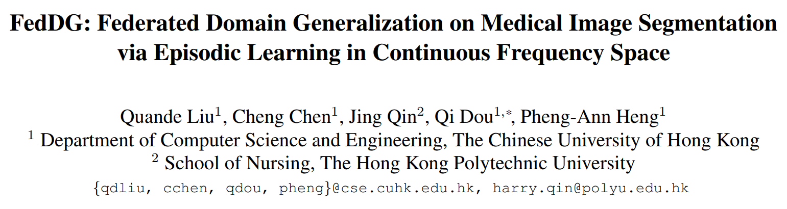
Federated Domain Generalization
Liu, Quande, Cheng Chen, Jing Qin, Qi Dou, and Pheng-Ann Heng. "Feddg: Federated domain generalization on medical image segmentation via episodic learning in continuous frequency space." In Proceedings of the IEEE/CVF conference on computer vision and pattern recognition, pp. 1013-1023. 2021.

Slide 24
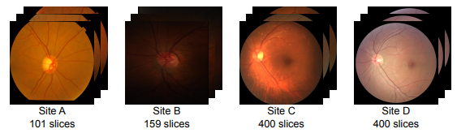
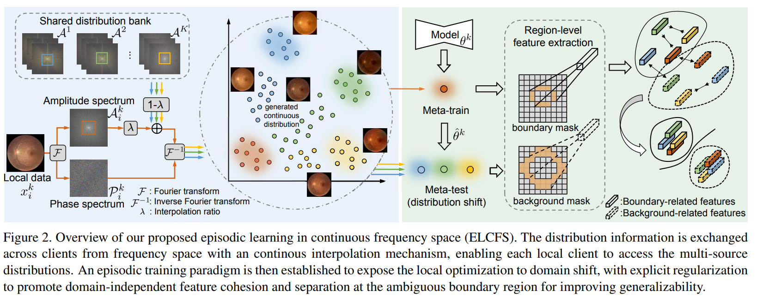
Fourier-Transform-based Federated Domain Generalization

Slide 25
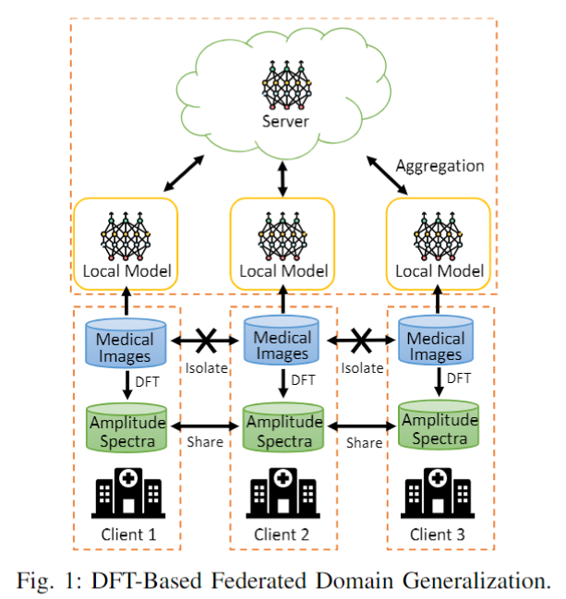
Fourier-Transform-based Federated Domain Generalization
We share Fourier magnitude spectra (amplitude spectra), which contain the style information
We retain Fourier phase spectra, which contain the object information
One cannot reconstruct the image with magnitude only.

Slide 26
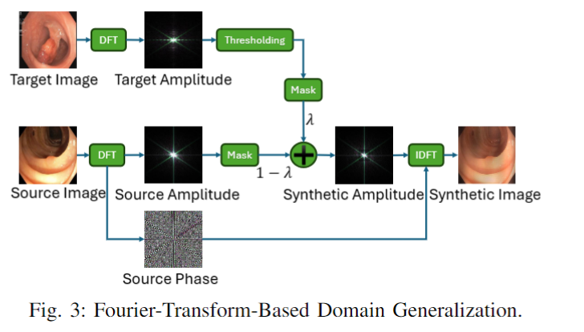
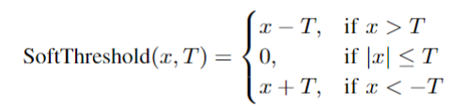
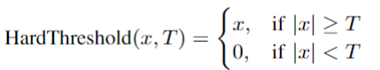
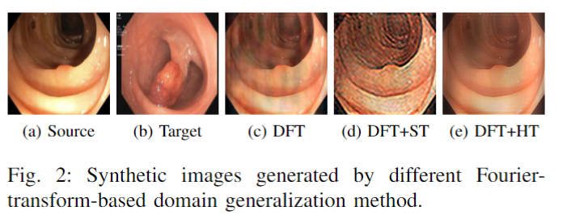
Fourier-Transform-based Federated Domain Generalization

Slide 27
Federated learning for medical image analysis: Polyp Segmentation
 | IOU↑ | DSC↑ | F2↑ | HD↓
FedAvg | 0.7882 | 0.8596 | 0.8568 | 41.80
+FedDG-ELCFS (Original DFT) | 0.7890 | 0.8618 | 0.8641 | 42.43
+FedDG-GA | 0.7888 | 0.8621 | 0.8633 | 42.56
+FedDG-DFTST | 0.7876 | 0.8611 | 0.8594 | 42.47
+FedDG-DFTHT | 0.7950 | 0.8658 | 0.8621 | 41.27
Train on PolypGen (6 centers), test on Kvasir-SEG.

Slide 28
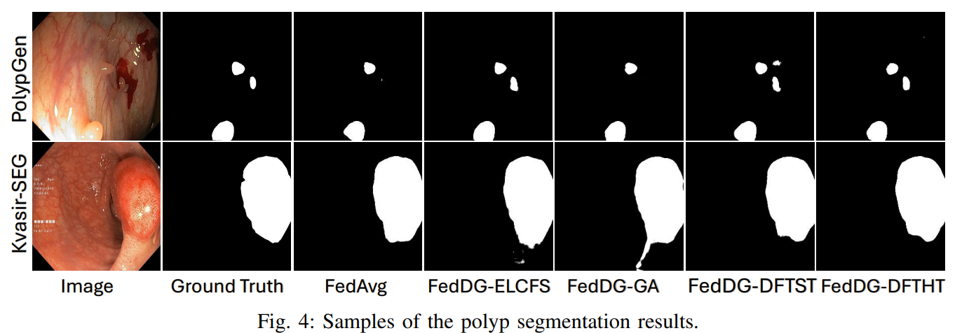
Federated learning for medical image analysis: Polyp Segmentation

Slide 29
Conclusion
Federated Averaging (FedAvg)
Federated Optimization in Heterogeneous Networks (FedProx)
Fourier-Transform-based Federated Domain Generalization
Pancreas MRI IPMN risk classification
Polyp Segmentation

Slide 30
Thank you for listening!
Hongyi Pan, Ph.D.,
Postdoctoral Research Fellow,
Machine & Hybrid Intelligence Lab,
Department of Radiology, Feinberg School of Medicine,
Northwestern University,
737 N. Michigan Avenue Suite 1600,
Chicago, IL 60611, USA
hongyi.pan@northwestern.edu
Web: https://www.bagcilab.com

